Slide 1
Predicting the number of visits to physician using a hierarchical Poisson model: A case in the General Hospital of the city of St. John’s, Canada
BST 5220 Multilevel and Longitudinal Analysis Final Project
Cheng-You Tsai, Miao Cai
Introductor: Dr. Hong Xian
May 6, 2019

Slide 2
Introduction
This dataset is a part of the longitudinal dataset collected by the General Hospital of the city of St. John’s, Canada for six years from 1985 to 1990. The outcome is the count variable: Visit, which is the number of visits to a physician by each individual during a given year. Covariates include
Year (1-6)
Gender: (1=male, 2 =female)
Chronic: Chronic disease status (0=no chronic disease, 1=one chronic disease and so on), treated as continuous
Education: Education level (1 = less than high school, 2 = high school, 3 =university graduate, 4 = post graduate), treated as nominal
Age_base: Age at 1985
In addition, Family ID is family identification and ID is the family member identification.

Slide 3
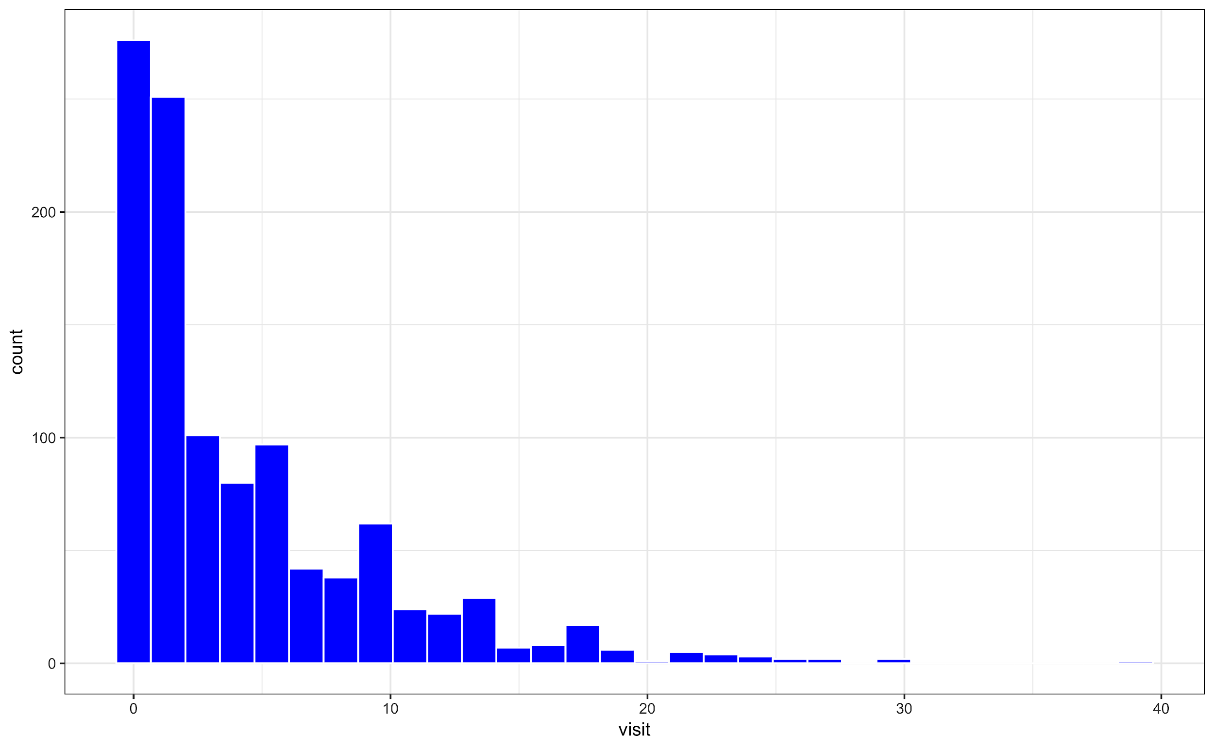
Histogram for data
Right-skewed
Notes:
the plot appears to be right-skewed.

Slide 4

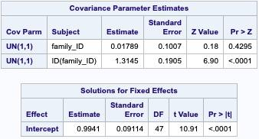
Step 1: Random-intercept only model
proc glimmix data=F.finalprojectdata_bst522 noitprint noclprint;
class family_ID ID;
model visit = / solution dist = poisson link = log;
random int / subject=family_ID type=un;
random int / subject=ID(family_ID) type=un;
COVTEST / WALD;
run;
Since the intercept at the family level is not significant (estimate: 0.01789, P-value = 0.4295), we excluded the random intercept at this level.

Slide 5
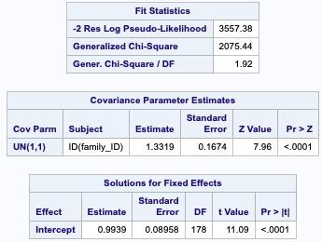
Step 2: Exclude insignificant random intercepts at family level
proc glimmix data=F.finalprojectdata_bst522 noitprint noclprint;
class ID family_ID;
model visit = / solution dist = poisson link = log;
random int / subject=ID(family_ID) type=un;
COVTEST / WALD;
run;
The level 2 (individual ID) random intercepts are significant (P-value = 0.029). Therefore, we keep the individual ID in the model.
The generalized Chi-square/df = 1.92, suggesting overdispersion or underfit of the model.

Slide 6
Step 3: Adjust for overdispersion
We added a scale parameter to the model – the R-side variance through the “random_residual_ /subject=ID(family_ID)” statement
proc glimmix data=F.finalprojectdata_bst522 noitprint noclprint;
class ID family_ID;
model visit = / solution dist = poisson link = log;
random int / subject=ID(family_ID) type=un;
random _residual_ /subject=ID(family_ID);
COVTEST / WALD;
run;

Slide 7


Step 3: Adjust for overdispersion
R-side variance = 2.10: the overdispersion parameter
The level-2 variance = 1.01
Both level-1 and level-2 variances are significantly different from 0

Slide 8


Comparison
Model parameter without the scale parameter
At the third step, we can see that the model parameter results with and without the scale parameter are very similar
Model parameter with the scale parameter

Slide 9


Step 4: Adding level-1 variable : Year
proc glimmix data=F.finalprojectdata_bst522 noitprint noclprint;
class ID family_ID;
model visit = year/ solution dist = poisson link = log;
random int/ subject=ID(family_ID) type=un;
random _residual_ /subject=ID(family_ID);
estimate 'year' year 1 /exp cl;
COVTEST / WALD;
run;
Level-1 variance reduced from 2.10 to 2.04
Level-2 variance slightly increased (from 1.01 to 1.02)

Slide 10
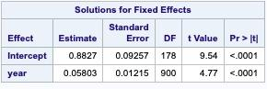

Step 4: Adding level-1 variable : Year
For every one additional year, the mean number of visits to physician is increased by 5.97 %

Slide 11
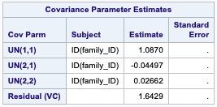
Step 5: Add year random slope effect
proc glimmix data=F.finalprojectdata_bst522 noitprint noclprint;
class ID family_ID;
model visit = year/ solution dist = poisson link = log;
random int year/ subject=ID(family_ID) type=un;
random _residual_ /subject=ID(family_ID);
Estimate 'year' year 1/expcl;
COVTEST / WALD;
run;
After adding time random slopes, the algorithm cannot converge, so we exclude the year random effects and only use year as fixed effects.

Slide 12


Step 6: Add level 2 variables
proc glimmix data=F.FinalProjectData_bst522 noitprint noclprint;
class ID family_ID gender (ref=first) education (ref=first) ;
model visit = year gender chronic education age_base / solution dist = poisson link = log;
random int / subject=ID(family_ID) type=UN;
random _residual_ /subject=ID(family_ID);
estimate 'year' year 1 /exp cl;
estimate 'F vs M' gender 1 -1 /exp cl;
estimate 'chronic' chronic 1 /exp cl;
estimate 'high school vs less than high school' education 1 0 0 -1 /exp cl;
estimate 'university graduate vs less than high school' education 0 1 0 -1 /exp cl;
estimate 'post graduate vs less than high school' education 0 0 1 -1 /exp cl;
estimate 'age_base' age_base 1 /exp cl;
COVTEST / WALD;
run;
Level-2 variance reduced from 1.02 to 0.70
Level-1 variance (2.04) remained the same

Slide 13
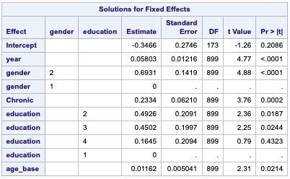
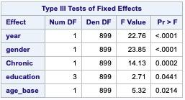
Step 6: Add level 2 variables
All the type 3 tests of fixed effects are significant for the level 2 variables.

Slide 14
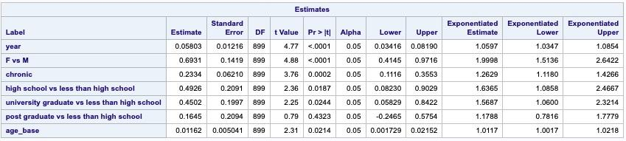
Step 6: Add level 2 variables
The mean number of visits to physician for female is two time that for male.
For every unit change in chronic status the number of visits to a physician by each individual is multiplied by exp(0.23)=1.26
The mean number of visits to a physician for people having an education of high school is exp(0.49)=1.64 times that for less than high school.
The number of visits to a physician for those having an education of university graduate is exp(0.45)=1.57 times that for less than high school.
For every unit change in age_basethe number of visits to a physician by each individual is multiplied by exp(0.01)=1.01

Slide 15
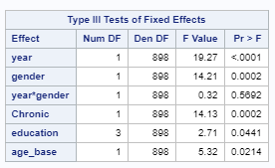
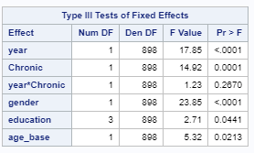
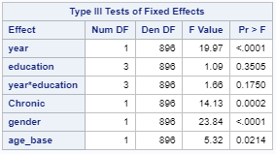
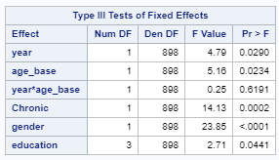
Step 7: Interaction between level 1 and 2 variables

Slide 16
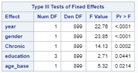
Final model : Step 6 model
Type 3 analysis suggests that the significant variables are year, gender, chronic disease, education, and age_base.

Slide 17
Final Model: Step 6 model
Controlling/adjusted for all other factors,
The number of visits to physician for every additional year is multiplied by exp(0.06) = 1.06
The number of visits to physician for female is two time that for male.
For every unit change in chronic status the number of visits to a physician by each individual is multiplied by exp(0.23)=1.26
The number of visits to a physician by each individual for people having an education of high school is exp(0.49)=1.64 times that for less than high school.
The number of visits to a physician by each individual for people having an education of university graduate is exp(0.45)=1.57 times that for less than high school.
For every unit change in age_base, the number of visits to a physician by each individual is multiplied by exp(0.01)=1.01

Slide 18


